Slide 1


Designing and Exploring the Structure of Launch Vehicles to Create Optimal Theoretical and Small-Scale Experimental Models
Cole Errico
Aerospace Engineering
Arizona State University
Tempe, AZ
Timothy Takahashi, JD/PhD
Aerospace Engineering
Arizona State University
Tempe, AZ

Slide 2
Motivation – Ease of Design
Design is arguably the most time-consuming aspect of any astronautics project and consumes enormous amounts of labor and cost for any size of undertaking.
  Every little detail of every piece prepared for the launch must be meticulously designed to optimize for any number of properties.
  Being able to automatically produce a functional design that applies to any portion of the design will cut down on cost and time drastically.
GOAL: Create a series of programs to generate feasible and scalable models for a launch vehicle that can be applied to real-life applications.

Slide 3
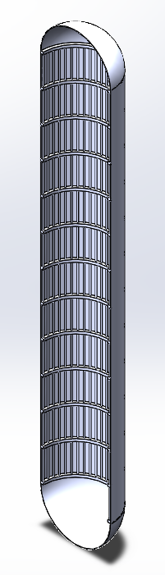
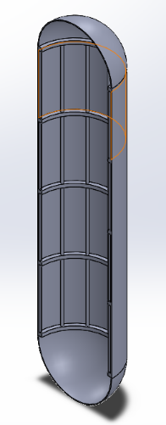
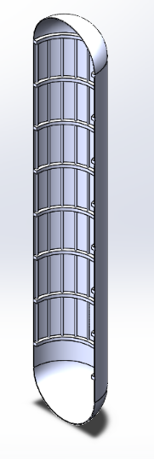
What we did – Launch Vehicle Propellant Tank Design
By using a combination of programs, 3 main sizes of design were created
Models went through many stages of development to ensure they could support the loadings and stresses caused by launch

Slide 4
Overall Performance Goals
The main goal of performance optimization was to maintain a staging-altitude of ~140,000 feet while minimizing structural weight
G-forces and compressive loads also something to keep aware about

Slide 5
Design Parameters – End Results
Main inputs needed in order to generate a design*:
  Structure material: aluminum 6061
  Fuel: liquid hydrogen; oxidizer: liquid oxygen
    Starting fuel: 17000 lbs; starting oxidizer: 52000 lbs
  Thrust:Weight of engine: 54
  Inner tank diameter: 10.8 ft
    Thickness: 1 in
  Factor of safety = 1.1
* Final values

Slide 6
Microsoft Excel – Simulating a Launch
A simple rocket launch file created prior to the project was populated with the geometry, fuel and oxidizer weight from the initial launch vehicle model
Accounts for all forces acting on the body at a given time
Calculates any necessary quantities and “steps forward” in time
  Repeats process until the vehicle depletes its supply of oxidizer, fuel, or goes below a pre-determined minimum weight
Values at each instant in time are populated into a main table and are used to create graphs/charts for desired variables
Notes:
Talk about Solidworks?
Drag, thrust, weight loss

Slide 7
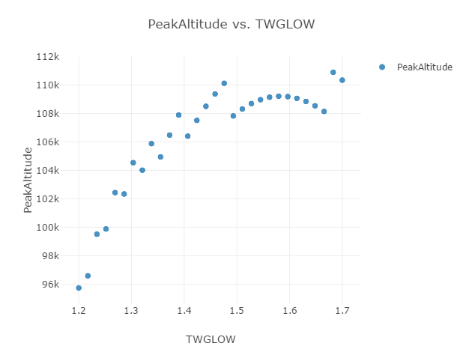
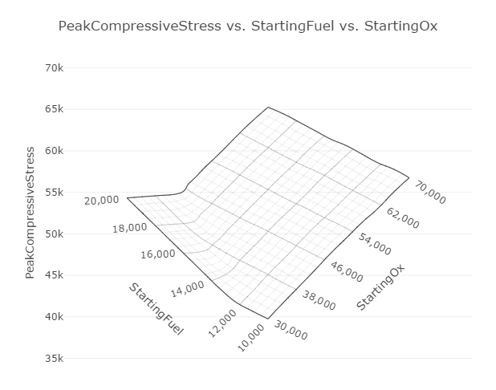
Optimization – ModelCenter
Apparent that some values couldn’t be directly optimized easily using Excel
Used ModelCenter to run trade studies on one/multiple variables through a range of values to determine outputs
Ran trade studies on:
  Structural parameters (thickness, radius, length)
  Fuel and oxidizer initial weight
  Thrust
Notes:
Fuel vs oxidizer to get lowest amount of weight/compressive loads
Maximum thrust to minimize loading and g-forces
Thickness of tube skin for lowest weight/highest structural stability
Other structural parameters for best strength:weight

Slide 8
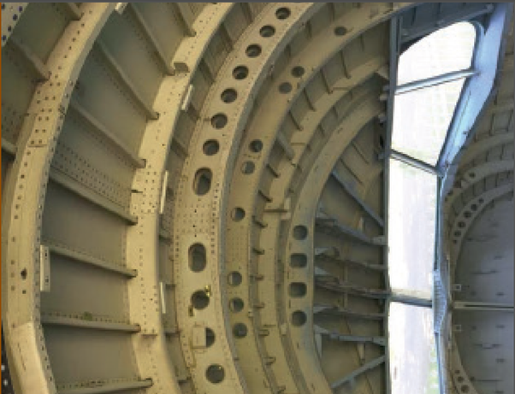
Ensuring Structural Stability
As the monocoque outer skin could not support all the forces by itself, it was necessary to add other ways to distribute the stresses
  Longitudinal stiffeners to assist with compressive loads and prevent buckling
  Hoop stiffeners to reduce hoop stresses and reduce length between longitudinal stiffeners (longerons)
A combination of Excel to connect the stiffeners to the main design and MATLAB to run the calculations on how many/how large the stiffeners would need to be were applied to support loadings
Source: https://www.quora.com/
Notes:
Variable skin thickness (wherever stresses are high/low)
Longitudinal and hoop stiffeners to provide structural support
-Types of collapse?

Slide 9
What about scaling?
Final (and arguably most important) objective was to determine whether a design could be scaled up or down by changing a few parameters
Went back to the Excel simulation – goal was to scale booster so cross-sectional area was 0.5 and 1.5 times the original model
Values of the Excel simulation were plugged into ModelCenter and refined, then into MATLAB for longerons and hoop stiffeners
All values were used with Solidworks in order to generate final models
Notes:
Height and diameter would remain in about the same ratio as the original model (~4.5)

Slide 10
Smaller Model
Diameter – 7.784 ft, thickness – 0.9 in, total length (height) – 25.85 ft

Slide 11
Larger Model
Diameter – 15.46 ft, thickness – 1 in, total length – 82.119 ft

Slide 12
To Sum it all Up
Simplifying or streamlining the design process for large scale aerostructures can bring benefits in terms of time and cost
Through a combination of programs and routines, a method of determining a structurally stable launch vehicle has been created
Further work into the real-life viability of these launch vehicles is needed in order to fully develop the model.

Slide 13
Acknowledgments
My mentor: Dr. Timothy Takahashi
The Ira A. Fulton Schools of Engineering and the School for Engineering of Matter, Transport, and Energy
The ASU/NASA Space Grant Program and the Arizona Space Grant Consortium

Slide 14
Thank you!

